Slide 1
Lecture 2: Databases, SQL, and ML
Slides reused from: SystemR Talk @ Spark Summit 2016 Kumar et al. @ SIGMOD 2017, Domingos @ CIKM 2013

Slide 2
Announcements
Waiting list: we are at capacity waiting to see if people drop etc.
How are groups going? We need the first 2 groups for next week!
A disclaimer on requirements
Background
Research project

Slide 3
Correction
Course Website: https://thodrek.github.io/CS839_spring18/

Slide 4
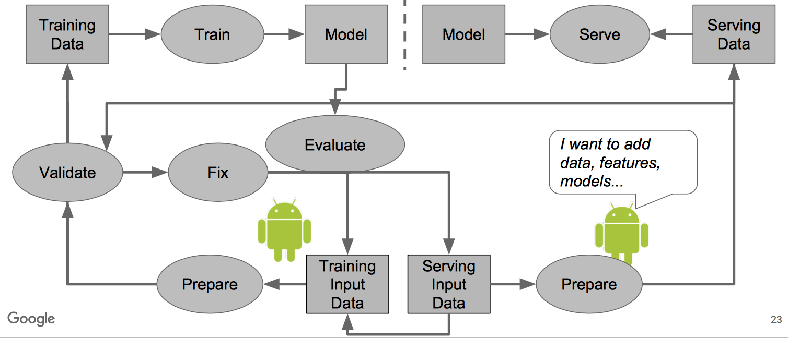
Previous lecture was all about data
Source: [Polyzotis et al., SIGMOD 2017]

Slide 5
Today’s focus
Source: [Polyzotis et al., SIGMOD 2017]

Slide 6
Today’s Lecture
ML, optimization, and SQL
Abstractions and execution plans
Statistical relational learning (SRL) and inference

Slide 7
1. ML, optimization, and SQL
Section 1

Slide 8
What you will learn about in this section
Section 1
Why ML in a Database?
From Least Squares to SQL
Stochastic Gradient Descent

Slide 9
Why data management and ML?
Section 1 > MLD
Answer:
We always recognized the value of data
The right abstractions for large-scale analytics became popular (Map Reduce)
The big data frenzy came

Slide 10
Section 1 > MLD

Slide 11
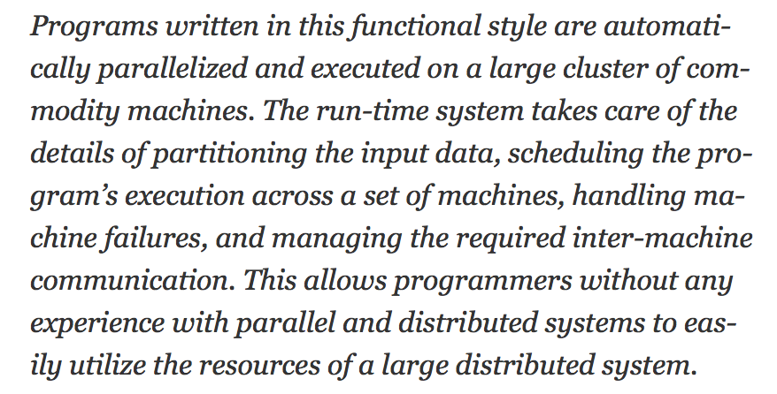
Why the MapReduce-Hadoop frenzy?
Section 1 > MLD
Source: [Dean and Ghemawat]

Slide 12
Section 1 > MLD

Slide 13
Why are databases so successful?
Section 1 > MLD
Concept: Applications do not need to worry about how the data is structured and stored
Logical data independence: protection from changes in the logical structure of the data
I.e. should not need to ask: can we add a new entity or attribute without rewriting the application?
Physical data independence: protection from physical layout changes
I.e. should not need to ask: which disks are the data stored on? Is the data indexed?
One of the most important reasons to use a DBMS. The other reason is SQL (logical, declarative language).

Slide 14
Section 1 > MLD

Slide 15
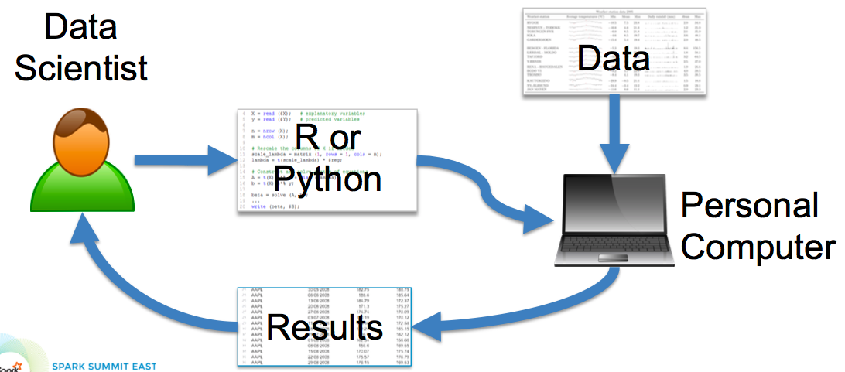
What about more involved analytics?
Section 1 > MLD
State-of-the-art back in 2009

Slide 16
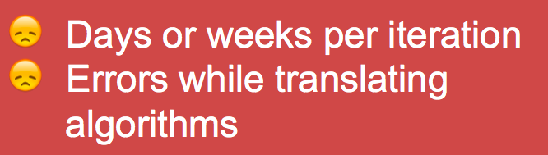
What about scalability?
Section 1 > MLD

Slide 17
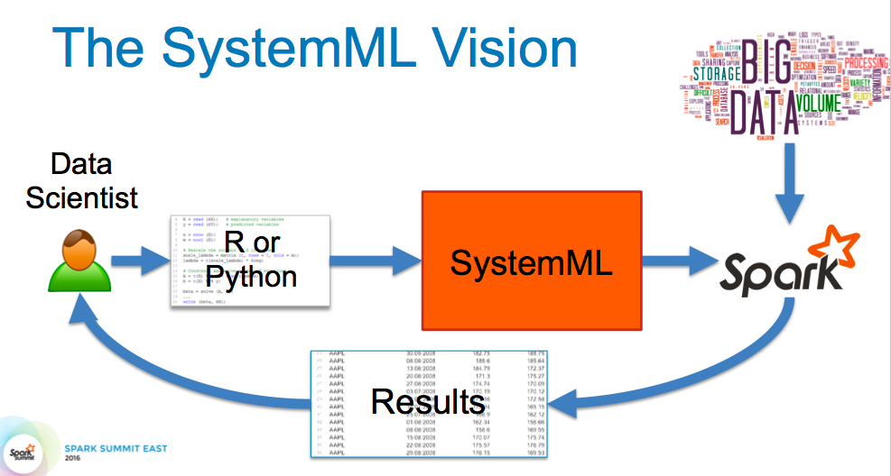
The rise of declarative ML
Section 1 > MLD

Slide 18
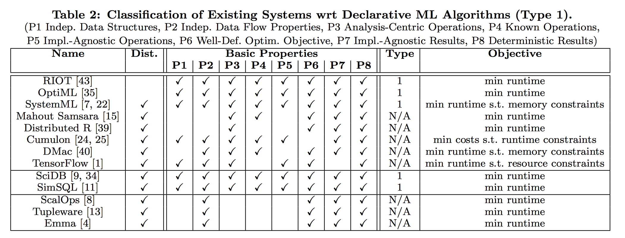
The rise of declarative ML
Section 1 > MLD
Source: [Boehm et al., Declarative Machine Learning – A Classification of Basic Properties and Types

Slide 19
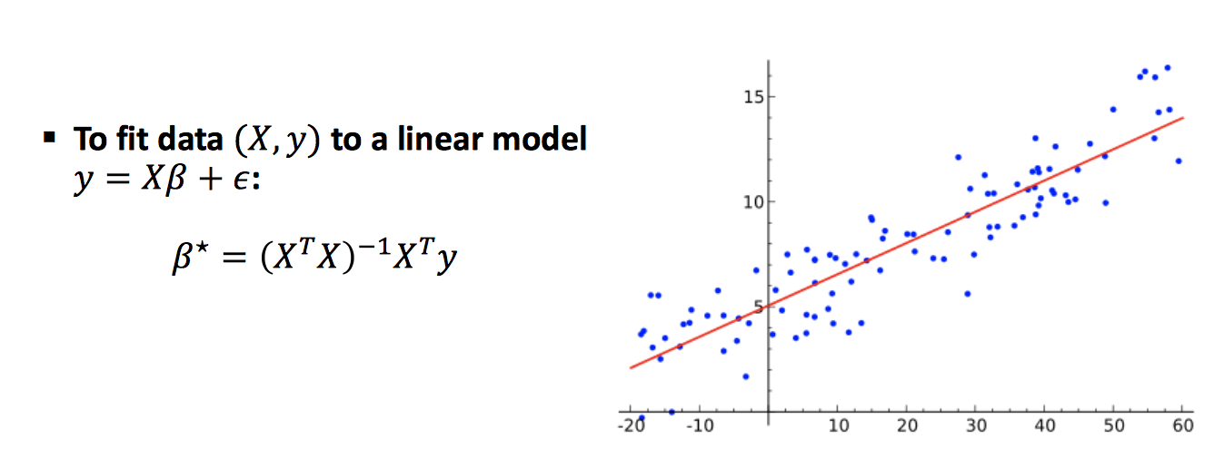
Simplest declarative ML program
Section 1 > MLD
Ordinary Least Squares

Slide 20
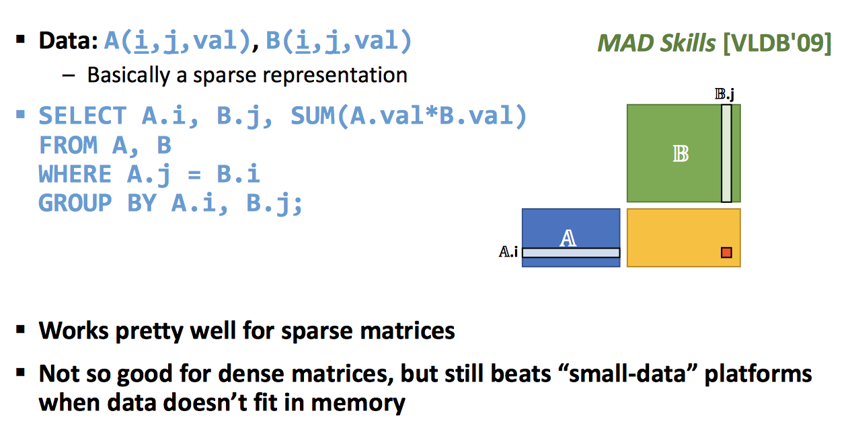
Matrix Multiply
Section 1 > MLD

Slide 21
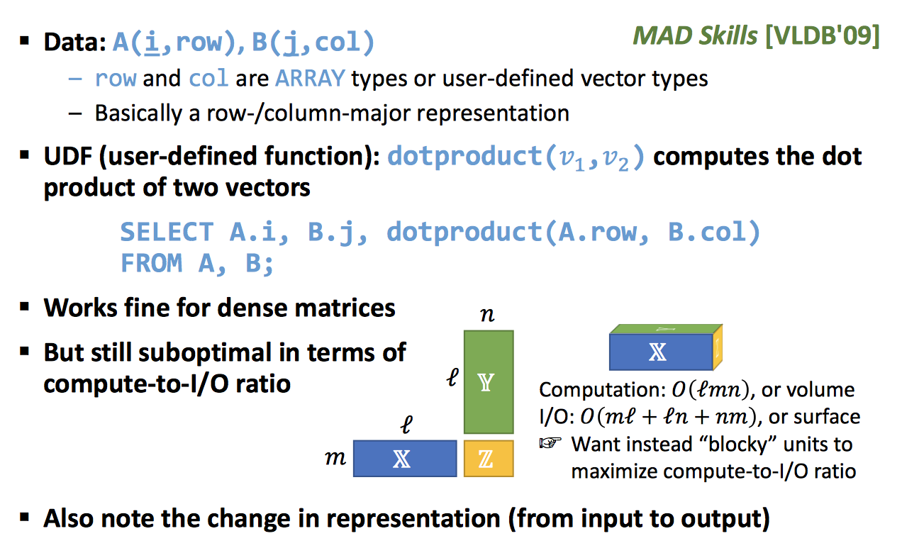
Matrix Multiply v2
Section 1 > MLD

Slide 22
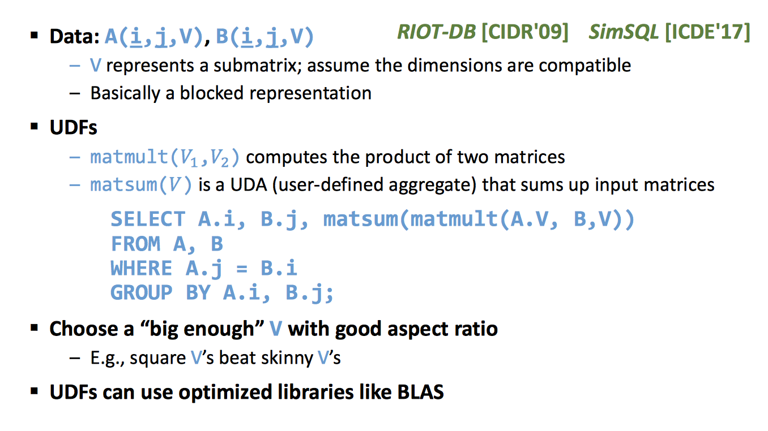
Matrix Multiply v3
Section 1 > MLD

Slide 23
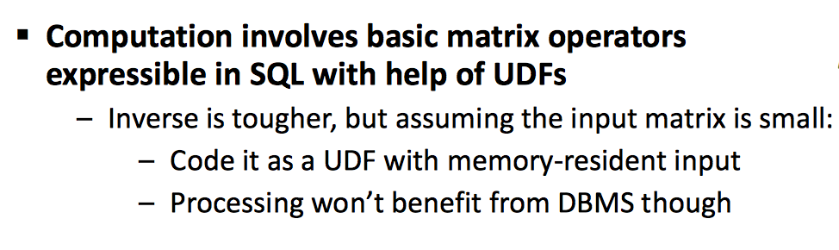
Simplest declarative ML program
Section 1 > MLD
Ordinary Least Squares

Slide 24
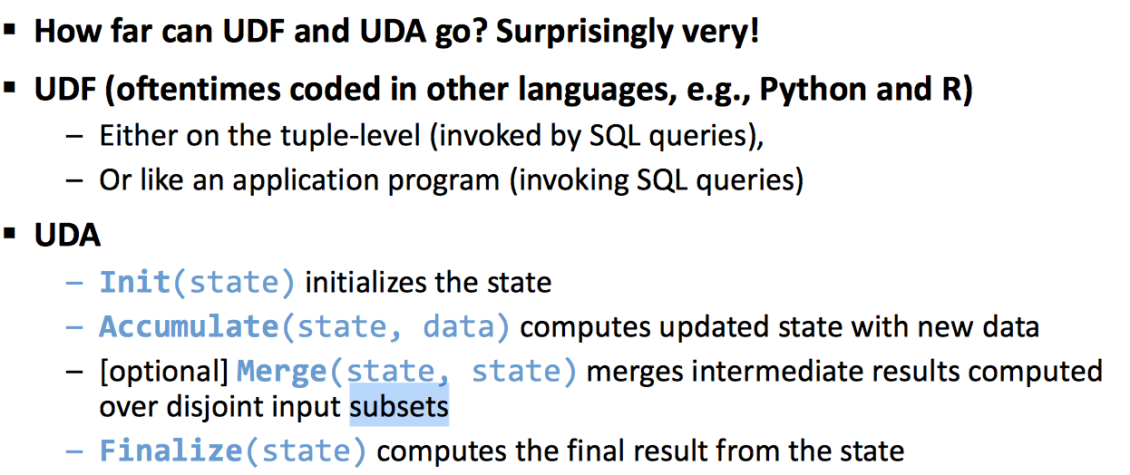
In summary
Section 1 > MLD
This pattern covers lots of iterative computation in ML

Slide 25
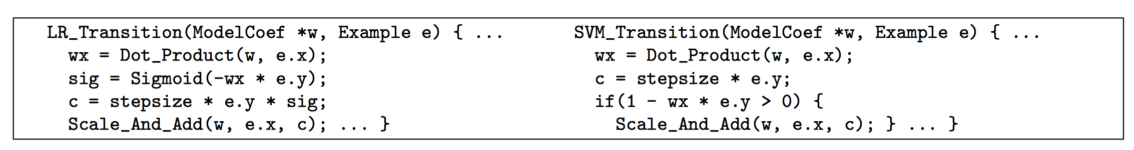
Example
Section 1 > MLD
Source: [Bismarck, SIGMOD 2012]

Slide 26
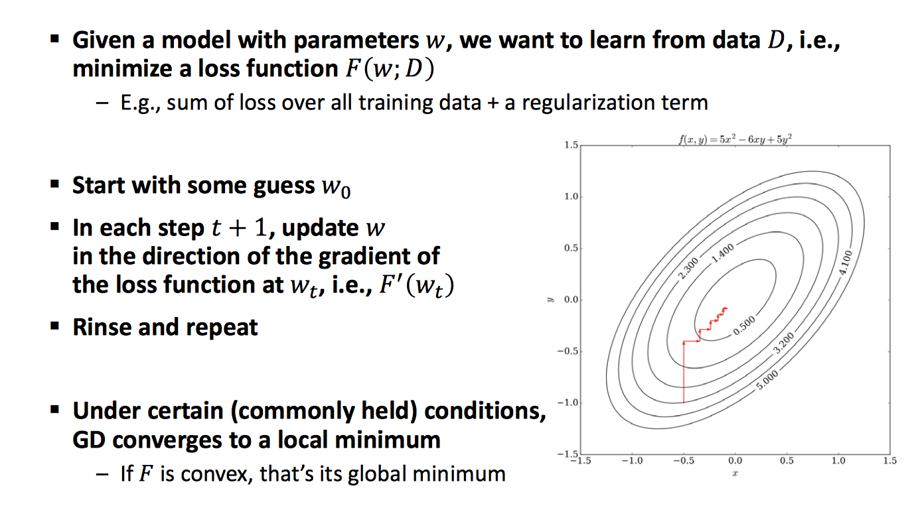
Gradient Descent (GD)
Section 1 > MLD

Slide 27
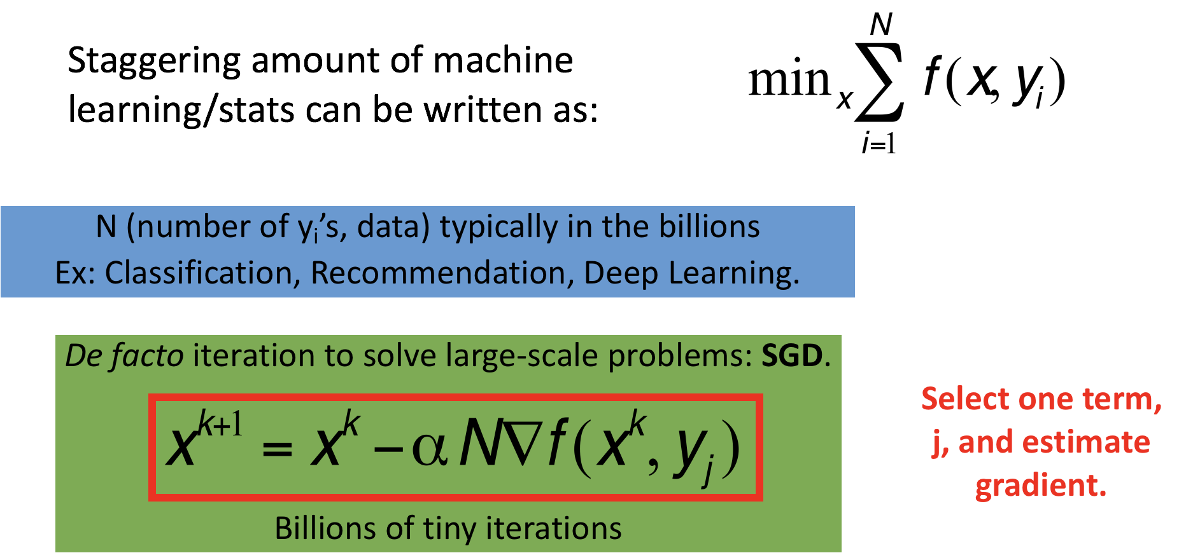
Stochastic Gradient Descent (SGD)
Section 1 > MLD

Slide 28
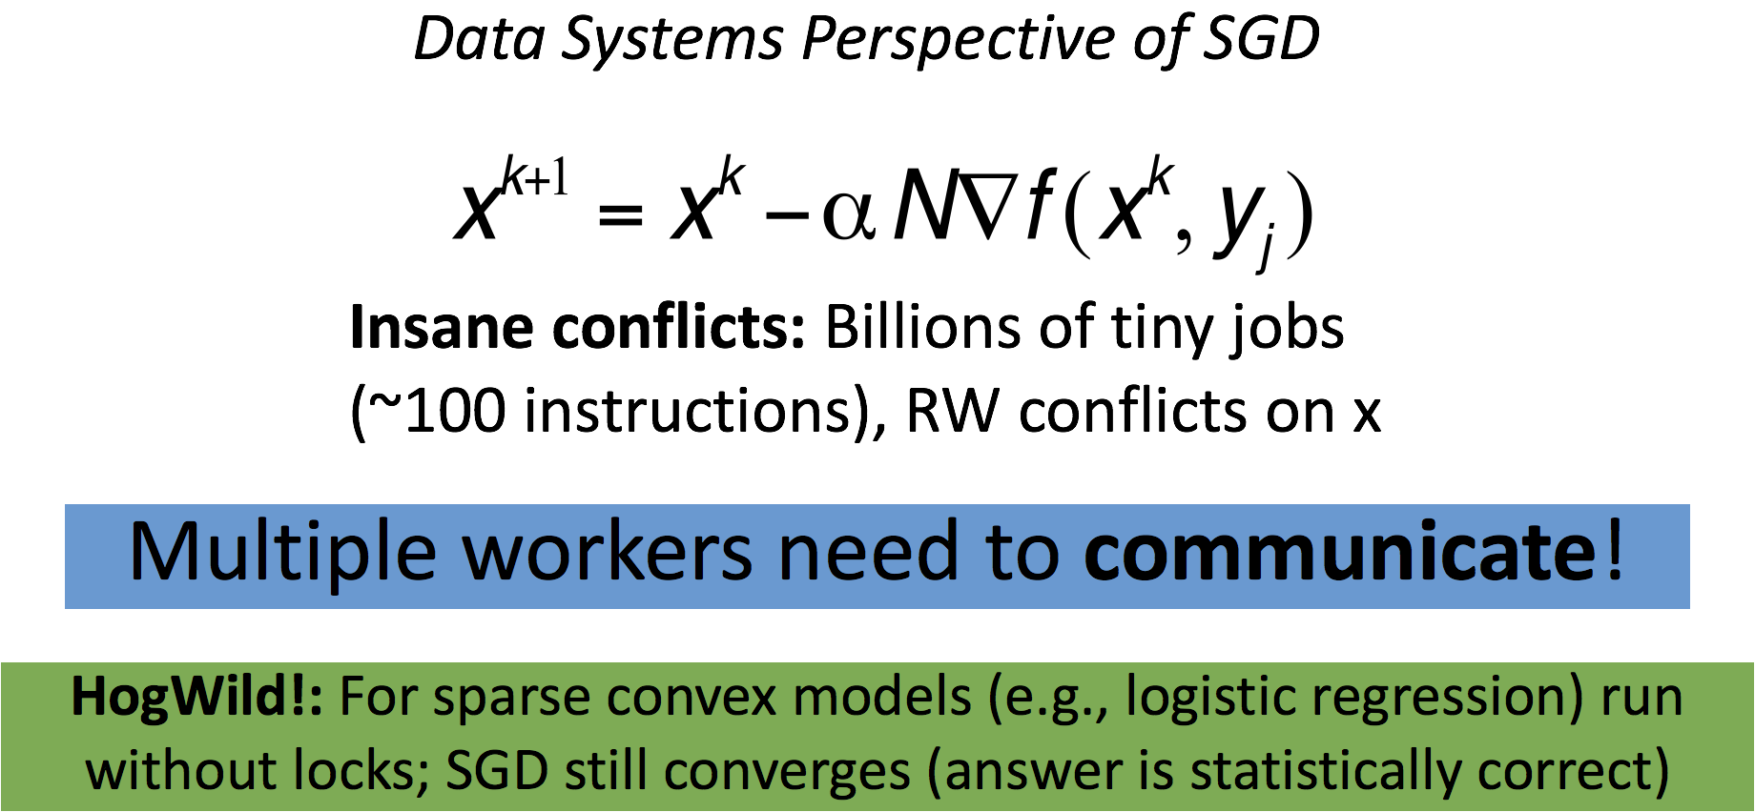
Stochastic Gradient Descent (SGD)
Section 1 > MLD

Slide 29
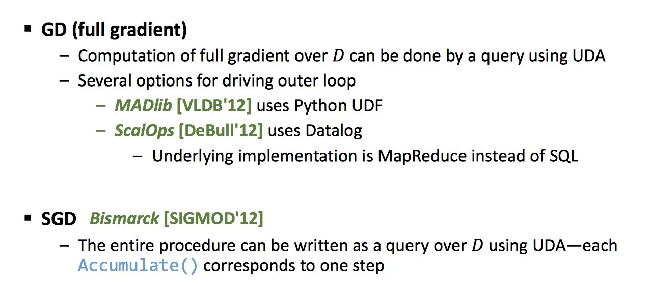
GD/SGD in SQL
Section 1 > MLD

Slide 30
2. Abstractions and execution plans
Section 2

Slide 31
What you will learn about in this section
Section 2
Execution in an RDBMS: The secret is your optimizer
ML-system optimizers

Slide 32
RDBMS Architecture
Lecture 2 > Section 2 > AEP
SQL Query
Relational Algebra (RA) Plan
Optimized RA Plan
Execution
Declarative query (from user)
Translate to relational algebra expression
Find logically equivalent- but more efficient- RA expression
Execute each operator of the optimized plan!
Relational Algebra allows us to translate declarative (SQL) queries into precise and optimizable expressions! Our optimization objective is to minimize IO cost!

Slide 33
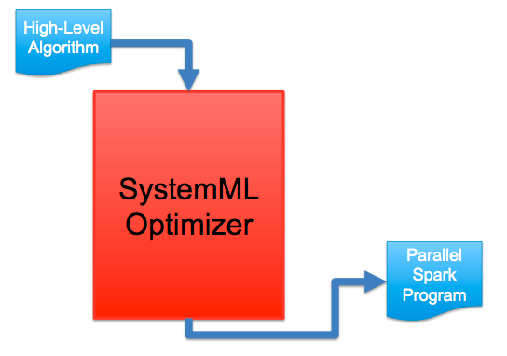
Declarative-ML-Systems Architecture
Lecture 2 > Section 2 > AEP
What is missing here?
Relational algebra!
But we have linear algebra!!!

Slide 34
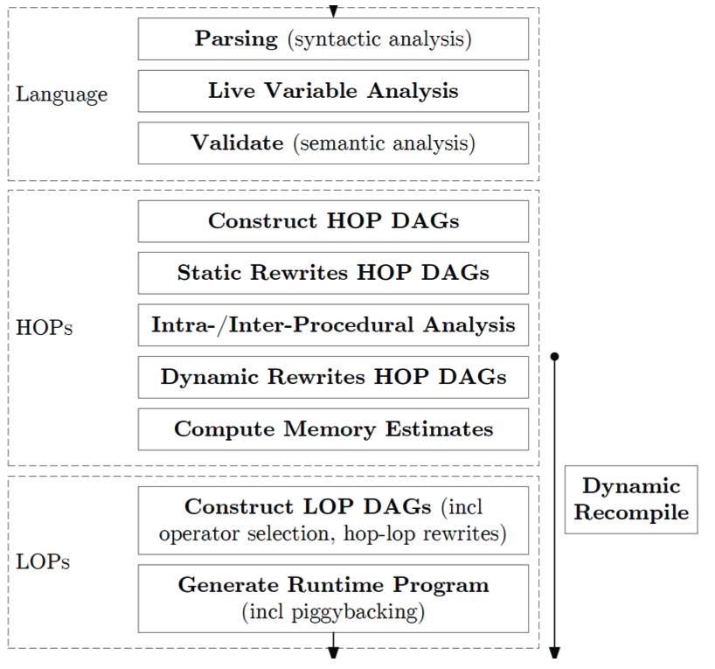
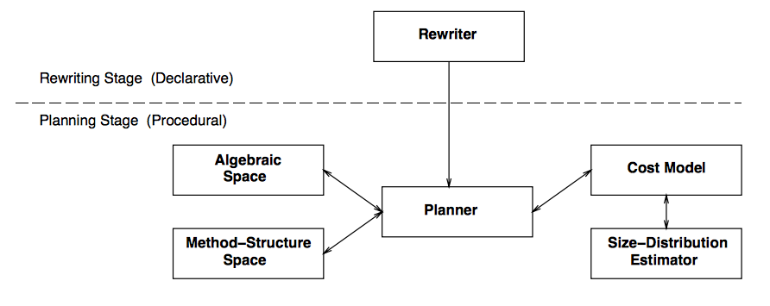
It’s about Optimizers
Lecture 2 > Section 2 > AEP
DB Query optimizer
The SystemML optimizer

Slide 35
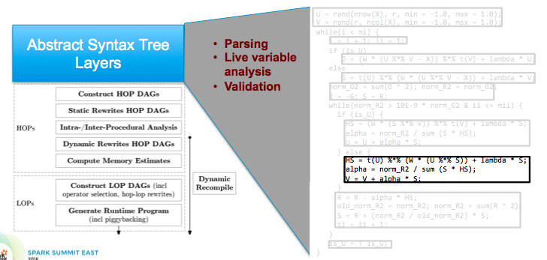
Example: the SystemML optimizer
Lecture 2 > Section 2 > AEP

Slide 36
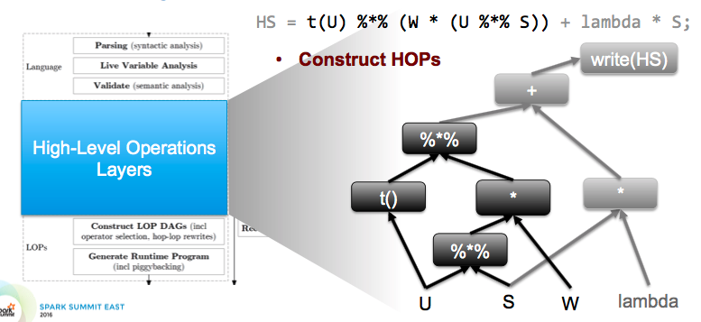
Example: the SystemML optimizer
Lecture 2 > Section 2 > AEP

Slide 37
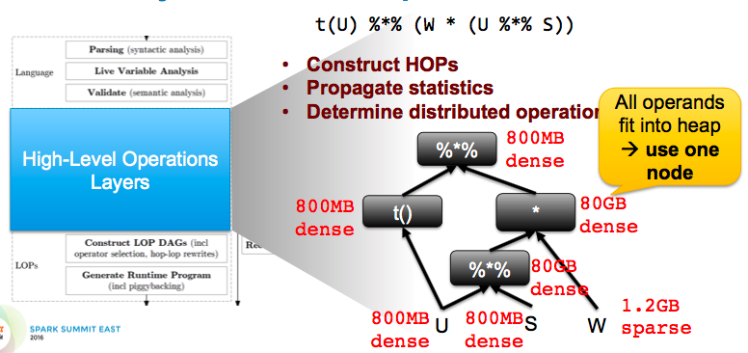
Example: the SystemML optimizer
Lecture 2 > Section 2 > AEP
And when it comes to execution, it’s all about sparse or dense data!

Slide 38
3. SRL and Inference
Section 3

Slide 39
What you will learn about in this section
Section 3
Motivation
SRL basics
SRL and DBs

Slide 40
Motivation
Section 3 > SRL
Most learners assume independently and identically distributed (i.i.d.) data
One type of object
Objects have no relation to each other

Slide 41
Motivation
Section 3 > SRL
What about other tasks? Say image segmentation? Are pixel predictions independent?

Slide 42
More examples
Section 3 > SRL
Web search
Information extraction
Natural language processing
Perception
Medical diagnosis
Computational biology
Social networks
Ubiquitous computing
Etc.
All examples of statistical relational learning problems. Relational refers to the relations between random variables.
SRL’s goal: Learn from non-i.i.d. data as easily as from i.i.d. data!

Slide 43
SRL basics
Section 3 > SRL
We have the elements:
Probability for handling uncertainty
Logic for representing types, relations, and complex dependencies between them
Learning and inference algorithms for each
Figure out how to put them together
Tremendous leverage on a wide range of applications

Slide 44
Markov networks
Section 3 > SRL
Undirected graphical models
Smoking
Cancer
Asthma
Cough
Potential functions defined over cliques
Smoking | Cancer | Ф(S,C)
False | False | 4.5
False | True | 4.5
True | False | 2.7
True | True | 4.5

Slide 45
Markov networks
Section 3 > SRL
Undirected graphical models
Smoking
Cancer
Asthma
Cough
Log-linear model:
Weight of Feature i
Feature i

Slide 46
Inference in Markov Networks
Section 3 > SRL
Goal: Compute marginals & conditionals of
Exact inference is #P-complete
Conditioning on Markov blanket is easy:
Gibbs sampling exploits this

Slide 47
MCMC: Gibbs sampling
Section 3 > SRL
state ← random truth assignment
for i ← 1 to num-samples do
for each variable x
sample x according to P(x|neighbors(x))
state ← state with new value of x
P(F) ← fraction of states in which F is true

Slide 48
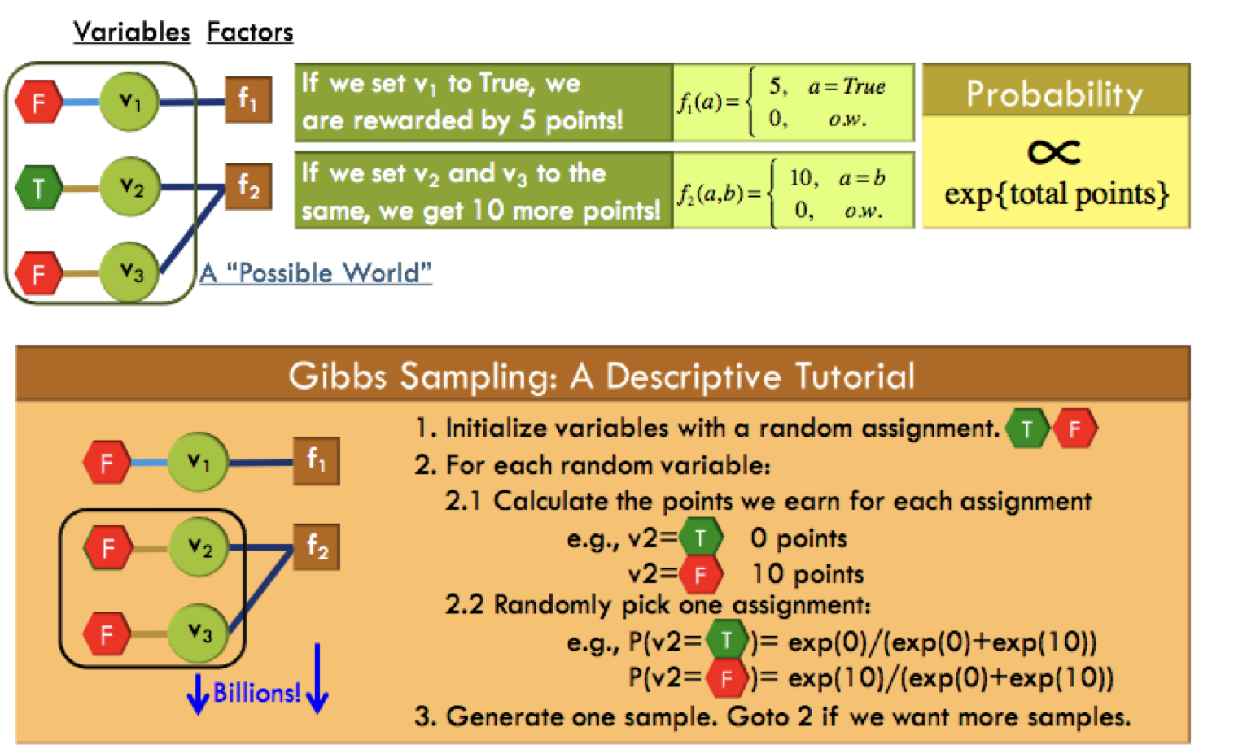
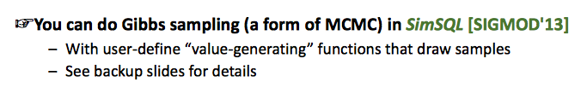
Probabilistic inference with Gibbs sampling
Section 3 > SRL

Slide 49
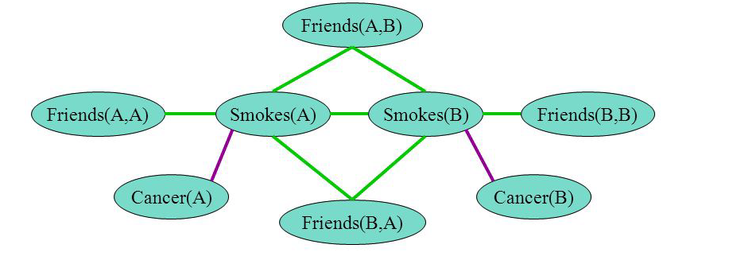
A better use of DBs: Templated Markov Networks
Section 3 > SRL
Markov networks capture interactions over random variables
Smoking causes cancer
Friends have similar smoking habits
How can we get such a network?

Slide 50
First-order Logic
Section 3 > SRL
Constants, variables, functions, predicates E.g.: Anna, x, MotherOf(x), Friends(x, y)
Literal: Predicate or its negation
Clause: Disjunction of literals
Grounding: Replace all variables by constants E.g.: Friends (Anna, Bob)
World (model, interpretation): Assignment of truth values to all ground predicates

Slide 51
Example
Section 3 > SRL

Slide 52
Example
Section 3 > SRL

Slide 53
Example
Section 3 > SRL
Two constants: Anna (A) and Bob (B)
Friends(A,B)
Friends(A,A)
Smokes(A)
Smokes(B)
Friends(B,B)
This is grounding.
Cancer(A)
Cancer(B)
Friends(B,A)

Slide 54
Markov Logic Networks
Section 3 > SRL
MLN is template for ground Markov nets
Probability of a world x:
Typed variables and constants greatly reduce size of ground Markov net
Functions, existential quantifiers, etc.
Infinite and continuous domains
Weight of formula i
No. of true groundings of formula i in x

Slide 55
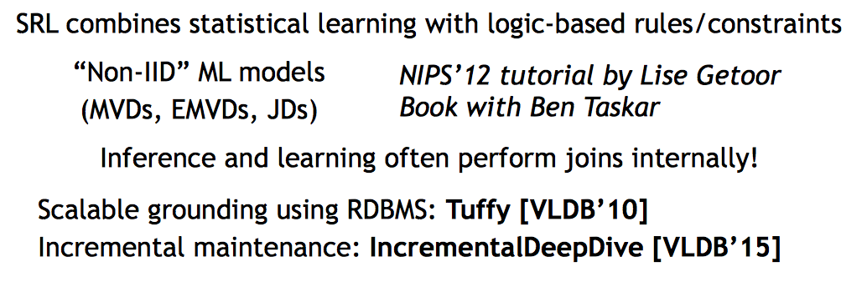
SRL; Deep RDBMS Integration
Section 3 > SRL
The secret is to express grounding as SQL statements!

Slide 56
DB and ML are very close!
Summary
It’s all about abstractions
SQL, relational algebra, and linear algebra
It’s all about optimizers
It’s all about indexing

